Slide 1


2021-2022 Annual Report

Slide 2



Craigwood's Organizational Pillars
Our Mission:
Our purpose is to deliver evidence-informed and result-driven community mental health services that meet the needs of children, youth and families in a timely, impactful and person centred way.
Our Vision:
Positive changes creating promising futures for children, youth and families.
Our Values:
Collaborative Accessible Responsive Excellence Stewardship
CRAIGWOOD CARES:
Providing what is needed for the well-being, nurture and safety of the children, youth and families we serve and our staff providing services.
Licensed By:
Accredited By:
Members of:
Craigwod 21/22 Annual Report

Slide 3
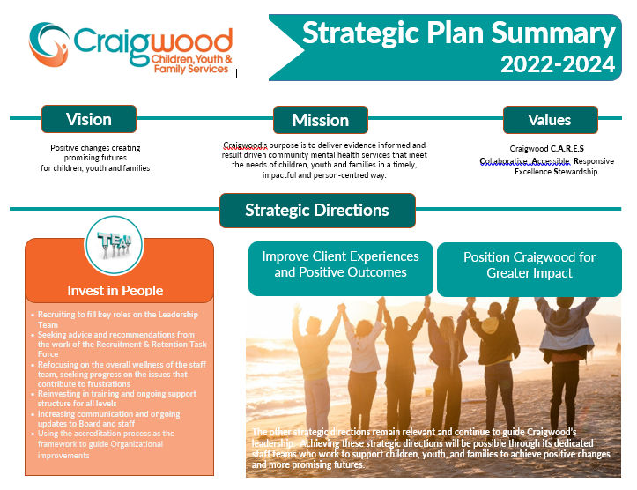
Positive changes creating
promising futures
for children, youth and families.
Craigwood’s purpose is to deliver evidence informed and results driven community mental health services that meet the needs of the children, youth and families in a timely impactful and person-centered way.
Craigwood C.A.R.E.S.
Collaborative, Accessible, Responsive, Excellence, Stewardship
Improve Client Experiences and Positive Outcomes
Position Craigwood for Greater Impact
Increase our strategies to continually monitor and improve client experience and outcomes
Leading with our strengths, increase our community services in support of current and future needs
Leverage technology and evidence-informed approaches to support clients, promote good data use and optimize internal systems
Apply Outcome measurements to demonstrate effectiveness, efficiency and positive change in all we do
Advance our Public Relations
Mitigate and manage risks while supporting the “hardest to serve”
Strengthen collaboration with current and new partners, and promote better system and organization integration
Build our relationships with key partners in the Health Sector
Diversify, stabilize, and strengthen financial resources and efficiencies
Embrace Diversity and Inclusion across the agency and with those we serve

Slide 4
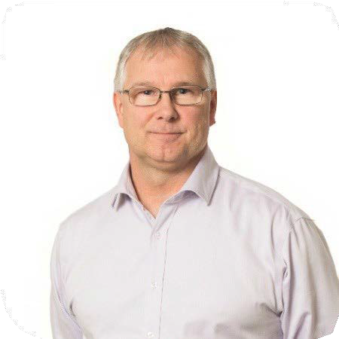
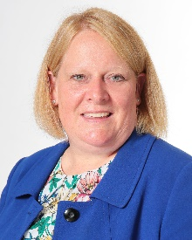
Message from the Board Chair and Executive Director
This year continued to highlight the incredible strength and resiliency of our clients, families and staff who are part of the Craigwood Children, Youth and Family Services community. We have definitely continued to experience the impact of the pandemic far longer than any of us might have anticipated. Through it all - staff and clients continued to overcome obstacles, demonstrate resiliency and create opportunities to grow and develop together.
In the past year, we also reflected on what it will take to recover from the pandemic and begin to move forward. We renewed our Strategic Plan with focus on three key areas: Starting with Investing in People, we will Improve Client Experiences and Positive Outcomes and Position Craigwood for Greater Impact. This year, we were pleased to welcome two new senior leaders to champion our Client Services and Human Resources department. The Craigwood Leadership team is dedicated to refocusing on the overall wellness of the staff, and reinvesting in training and support, recruitment and retention. Through these efforts, we continue to build a staff team that are well equipped to support our clients and families.
We are very proud of the work of our staff. Highlights from this this year’s work include: beginning equity, diversity and inclusion work starting with the board and leadership team; consolidation of our Live-In Treatment Services on our Campus; solidifying virtual counseling services as a highly accessible part of our continuum; and providing more community therapy services to those in need than ever before. As we focus our attention on Investing in People we are also using the next year to refresh what we do and renew our internal and external relationships with a lens towards our next accreditation.
Graham Ashbourne
Executive Director
2021-2022 Board Members
Chair
Sheila Powell
Co-Vice Chairs
Jim Boniferro
Veronica Ciszewska
Members
Frank Buzanis
Lori Turner-Otte
David Chen
Caroline Calmettes
Ashleigh DeCruz
Laura Di Cesare
Jessica Hon
Opeyemi Omonije
Ryan Bennett
Craigwood 21/22 Annual Report

Slide 5



Over the past few years, we have had to learn new ways of working and living both individually and as a community. Despite the challenges, we have been reminded of the need to continue our learning, to consider that there may be possibilities that we hadn’t considered and that sometimes we do need to challenge the status quo. As we move forward as an organization, this balance of building on our strengths and being open to new possibilities will serve us well.
A spirit of optimism, hope, courage and a recognition of the important work of our organization will provide us with the energy to fulfill our mission. We know how vital Craigwood’s work is in creating positive changes and creating promising futures for children, youth and families.
We are incredibly grateful to the staff, volunteers, funders, partners and donors for their commitment to Craigwood and for the trust placed in us by our clients, their parents and guardians. With deep appreciation for your collective support,
Graham Ashbourne Sheila Powell
Executive Director Board Chair
Craigwood 21/22 Annual Report

Slide 6

French Language Services Update
Craigwood est fière de pouvoir desservir les familles bilingues et francophones dans la langue de leur choix. Craigwood offre une intervention brève en français. Ce service s’étend de l’évaluation jusqu’à l’intervention thérapeutique pour les individus et leur famille.
In 2021, Craigwood was the recipient of a short-term grant under the Canada-Ontario Agreement on French Language Services - Annual Regional Projects 2021-2022. Craigwood’s project, Building Connection and Capacity: The French Language Service Alliance (FLS Alliance) is an initiative that seeks to improve access and delivery of mental health services to the Francophone community within London (a designated city under the French Language Services Act) and the surrounding area, as well as strengthen connections across French speaking mental health service professionals in our area and region. The FLS Alliance aims to work collaboratively with partners to reduce barriers for those seeking mental health services in French
Craigwood 20/21 Annual Report
6

Slide 7
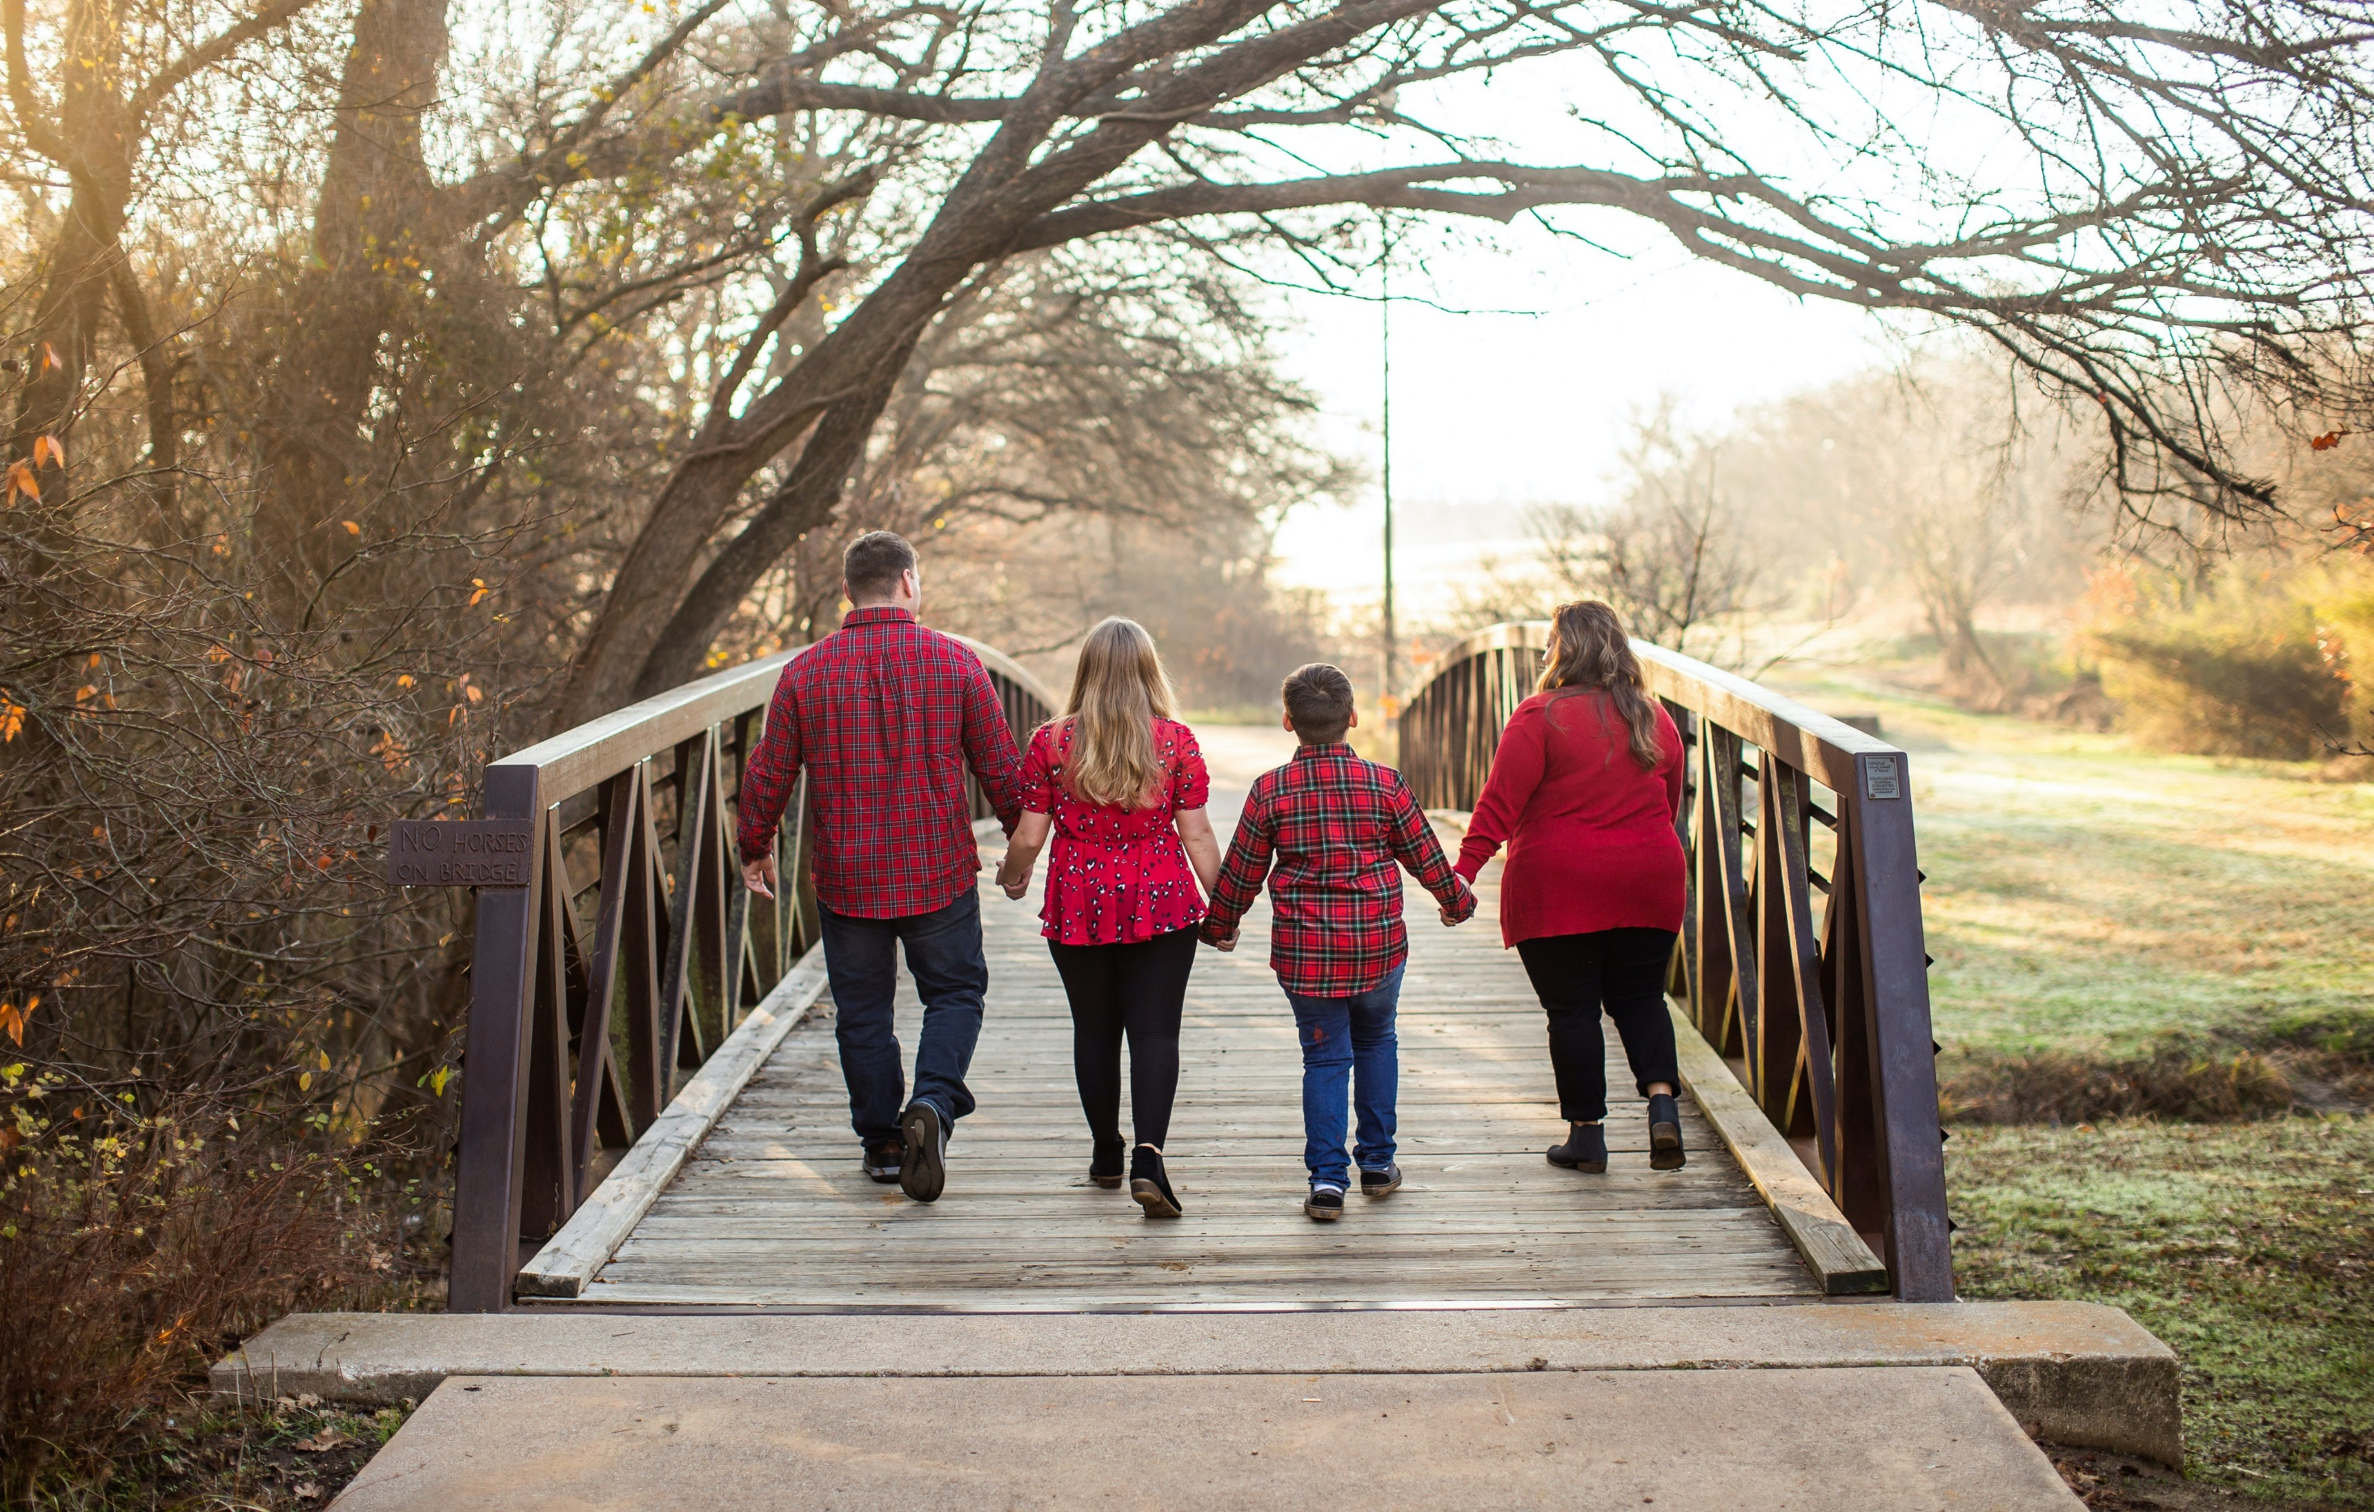
"This was a great starting
point and we have the resources for the future"
-Parents Feedback
“It wasn’t like any other place. They truly care about your wellbeing and support you unconditionally”
- Youth Feedback
Craigwood 20/21 Annual Report 7
Craigwood 20/21 Annual Report 7

Slide 8












"Truly, a big thank you for caring for our son over the last year. Our family was in major crisis mode a year ago. He is in a better position to succeed going forward.."
-Parent Feedback
Craigwood 21/22 Annual Report 8

Slide 9
Client Service Statistics
Craigwood 21/22 Annual Report 9

Slide 10
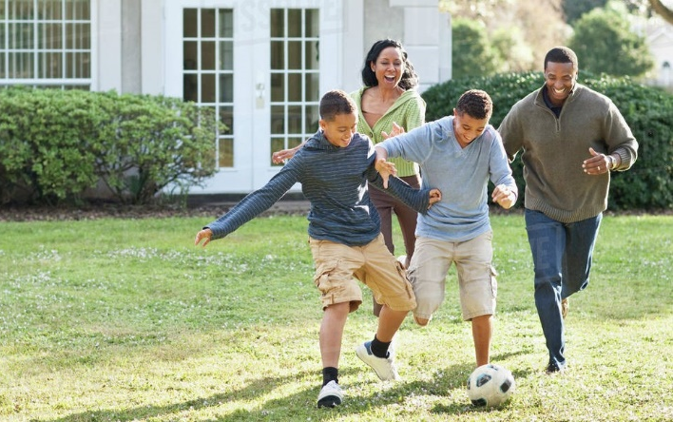
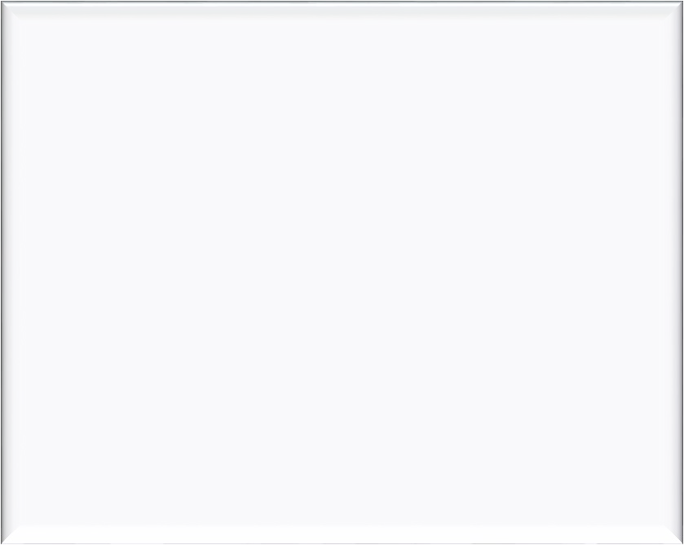
Thank you for helping us save our family and teaching us the skills to keep it together.
- Family Feedback
“It means the world to me that someone else has his back, and can see the person that he really is”
- Parent feedback
Craigwood 20/21 Annual Report 11

Slide 11
Financial
Repor
6%
7%
9%
6%
23%
37%
81%
31%
Craigwood 21/22 Annual Report
11

Slide 12
How to Support Craigwood
With your help today, Craigwood can continue to make a difference in the lives of children and families.
To donate, visit us online at www.craigwood.ca/donate
or contact us at donate@craigwood.on.ca
Craigwood 21/22 Annual Report
12

Slide 13





A Community Mental Health and Wellness Centre
Un centre communautaire de santé
mentale etde bien-être
www.craigwood.ca
519-432-2623
520 Hamilton Road London, ON N5Z 1S4
Reg#106991219RR0001
Craigwood 21/22 Annual Report
14

